Slide 1
The mental game
Pamela Smith, MD
Sports Psychiatry

Slide 2
The mental game
The Mental Game involves having sharp, well-conditioned mental skills for performance
Awareness of other mental health factors affecting performance
Having no mental game is an UNFORCED ERROR! The mental game can be an extra weapon/advantage - your “X-Factor”.

Slide 3
Mental Skills & Techniques to sharpen skills
Mental skills = processes of the brain controlling thought, feeling, and action
Techniques Used to Improve Mental Skills:
Relaxation (e.g. breathing & muscle relaxation)
Self-talk
Mindfulness
Imagery
Goal-setting
Mental routines
Core Mental Skills Involved in Athletic Performance:
confidence
motivation
attention or focus (staying in the moment)
emotion control (arousal/anxiety control)
Imagination for execution (i.e. imagining the execution of skills, plays, routines)

Slide 4
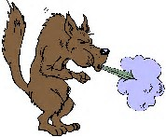
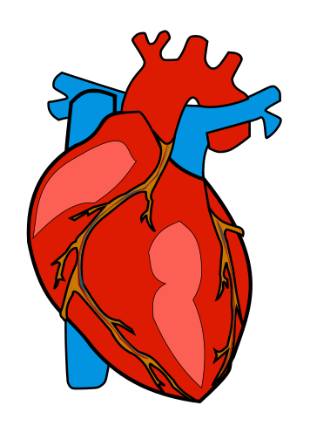

Relaxation – deep breathing
Used in sports to control emotions; refocus when distracted
Deep breathing stimulates the nervous system to decrease heart rate and relax muscles of the body.
*It’s the SLOW, FORCEFUL, EXHALE that actually activates nervous system to decrease heart rate and calm the body.
Exercise: The Big Bad Wolf
Inhale through your nose (and deeply from the diaphragm). Hold briefly. Then SLOWLY & FORCEFULLY EXHALE through your mouth (strongly pushing air out using the diaphragm). The exhale should be double the count of the inhale (e.g. inhale to the count of 3, hold for 1 count, then exhale to the count of 6). Again, be sure the exhale is slow, forceful, and extended. Repeat 5 times to create an effective rhythm.

Slide 5
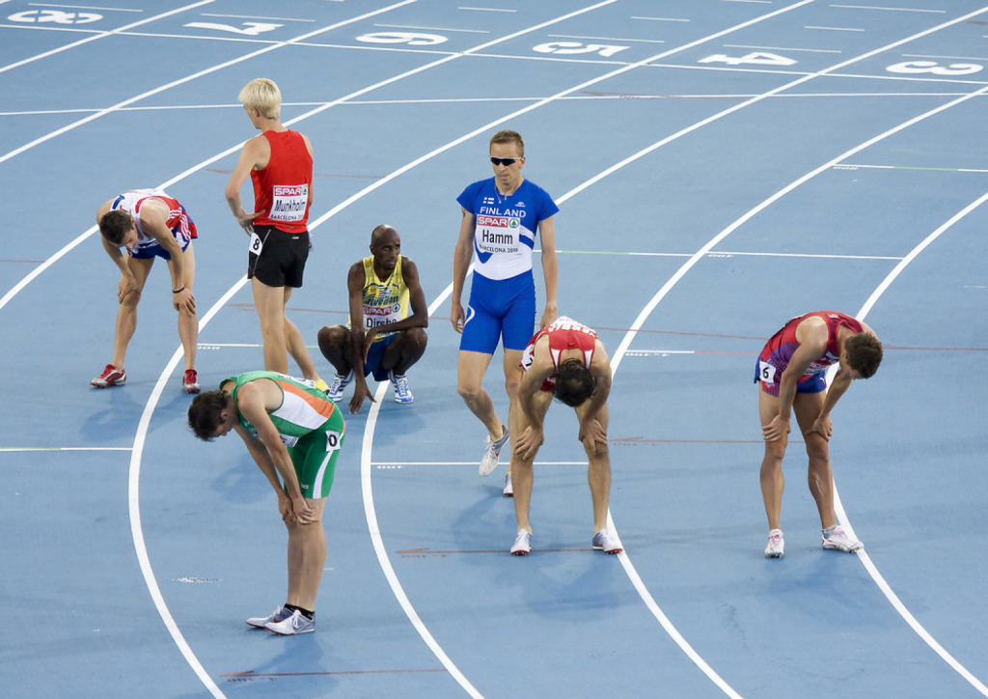
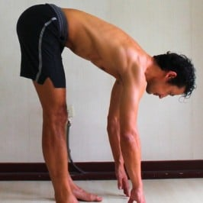
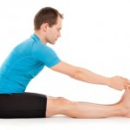
Relaxation – Muscle relaxation & FLEXION
Used in sports to control emotions, relax muscle tension, & refocus when distracted.
1. Progressive Muscle Relaxation – progressively tensing then relaxing of all muscle groups throughout the body
2. Waist flexion (bending at the waist): The action of bending forward or flexing at the waist (sitting or standing) stimulates the nervous system to slow the heart and relax the body.

Slide 6
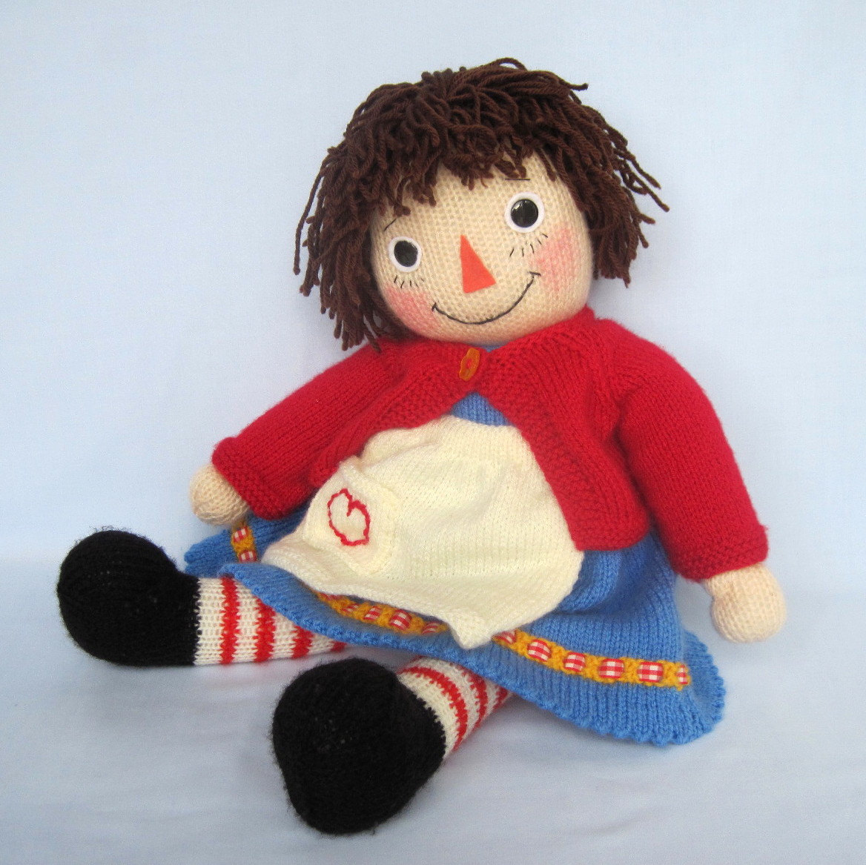
Relaxation – Muscle relaxation & FLEXION
Exercise: The Rag Doll
While standing or sitting, bend at the waist. In this position, do deep breathing i.e. deeply inhale, hold briefly; while slowly and forcefully exhaling, let your muscles go limp like a “rag-doll.” Repeat 5 times.

Slide 7
PRACTICE – PRACTICE - PRACTICE
1) After waking up
2) Before each meal
3) At bedtime

Slide 8
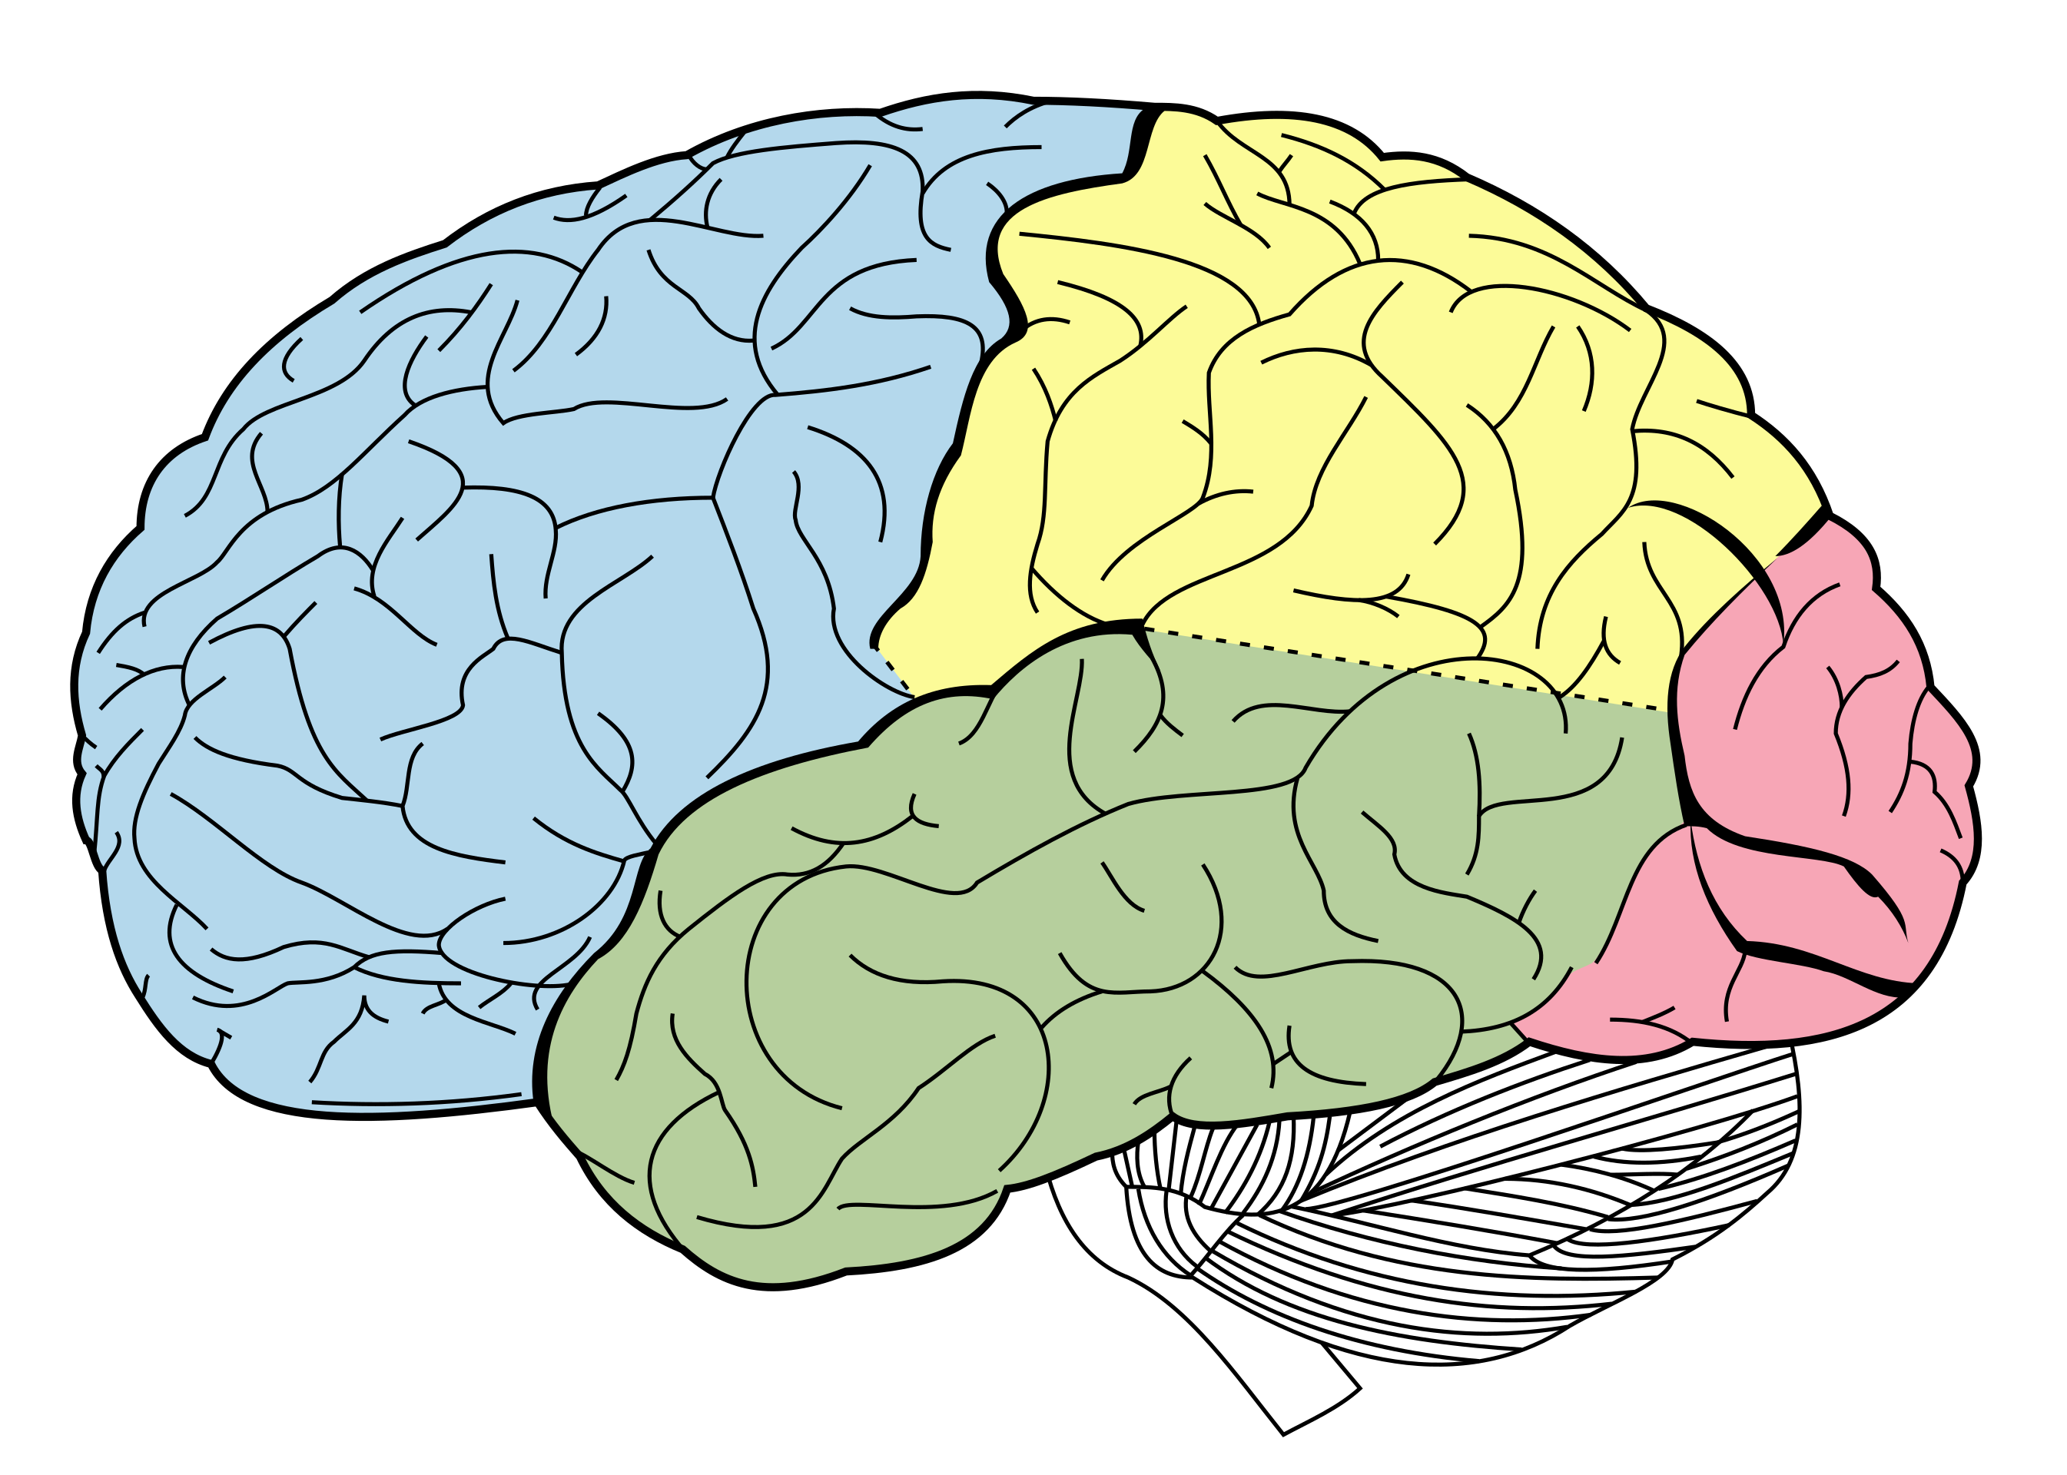
Talk can INFLUENCE emotion & MOTIVATION – Self-Talk
Human beings can be moved emotionally and motivated by “talk” including internal talk or “self-talk”
Self talk is the act or practice of talking to yourself either silently or aloud.
Self-talk may be positive/motivational (“I can do this;” “Let’s go!”), instructional (“keep my feet moving”), or negative (“I can’t do it”)
Positive self-talk is utilized to increase energy, effort, positive attitude, and confidence.
Positive, energized language has been associated with the release of brain chemicals (release of dopamine and noradrenaline in the prefrontal cortex), which is linked to certainty & confidence.
Frontal Lobe
Prefrontal cortex

Slide 9
Self-Talk
Rubber wristbands containing messages help make your self-talk clear and explicit (can also use sweatbands on wrist; a towel, journal, or water bottle on the bench)
Used by athletes in varied sports and on different levels (e.g. youth, collegiate, amateur, pro)

Slide 10
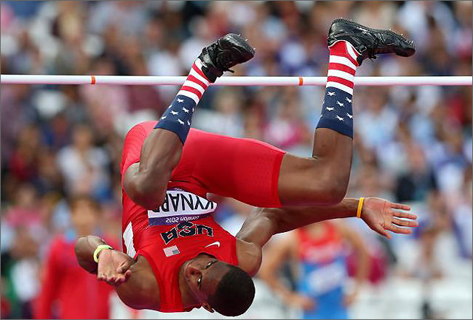

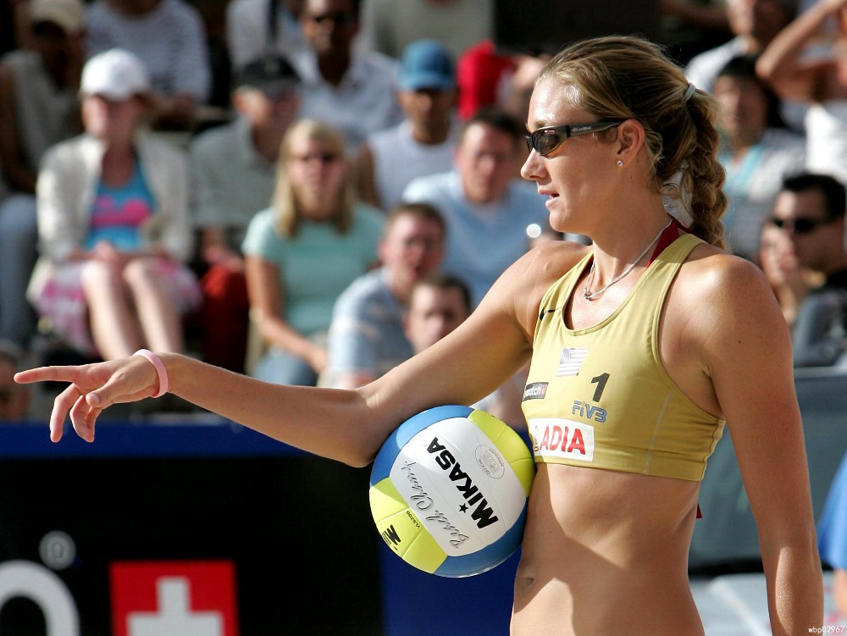
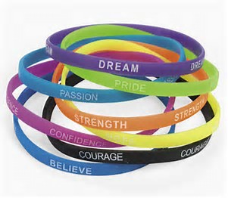
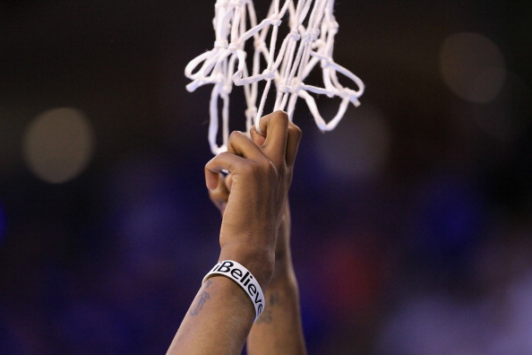
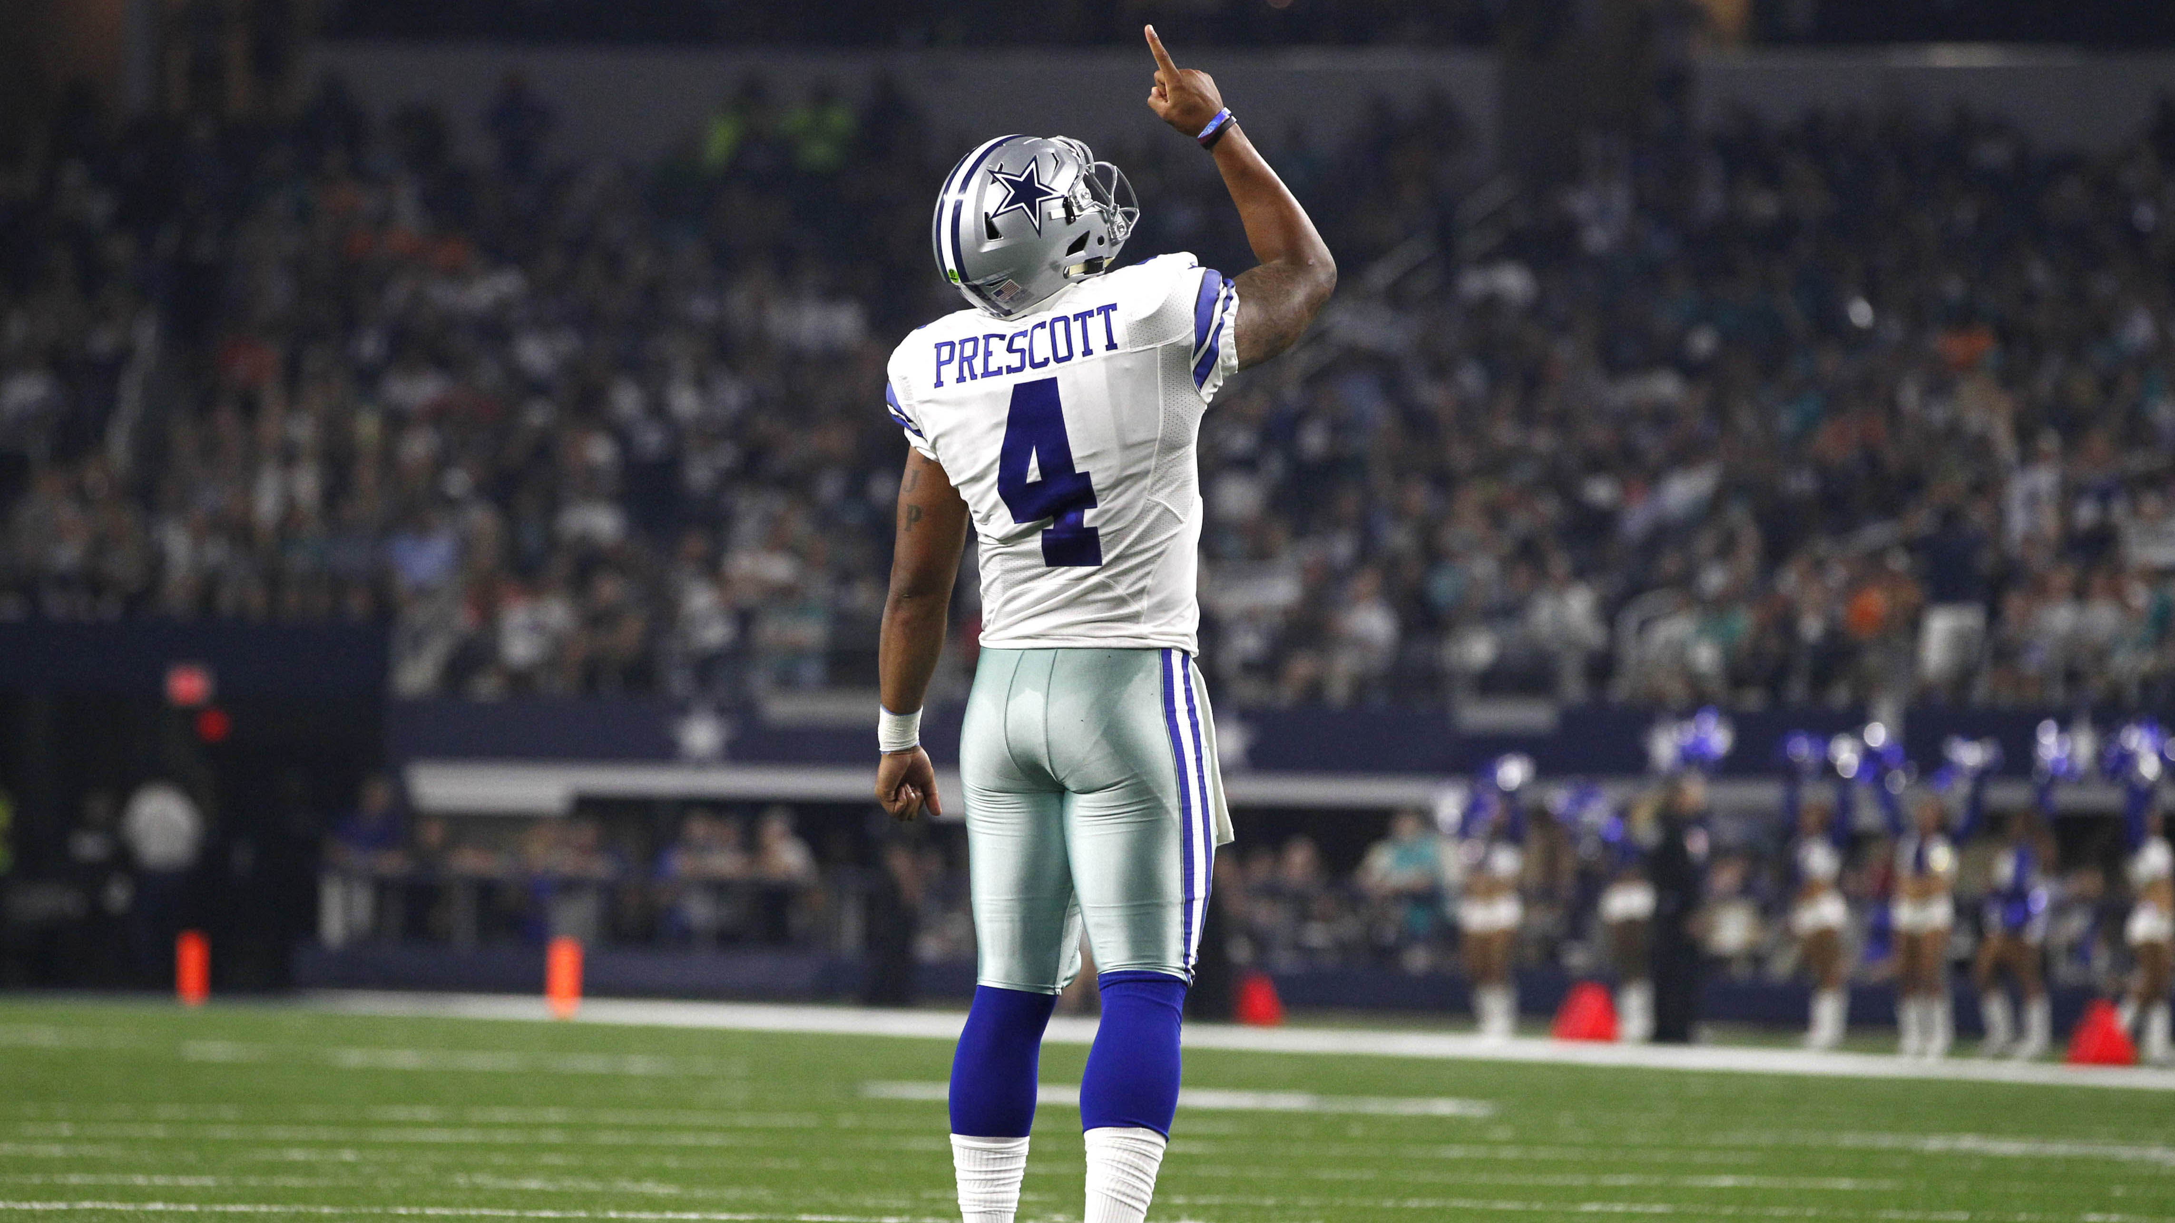

Slide 11
Mindfulness
Mindfulness = involves ability to shift attention and focus in the moment
In sports, the use of mindfulness involves being able to shift and move beyond mistakes or distractions and remain focused in a moment.
Attention
circuits
Attention circuits

Slide 12
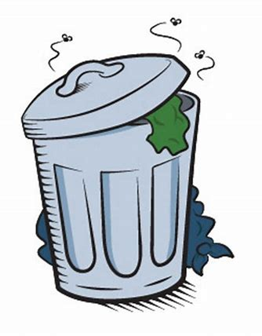
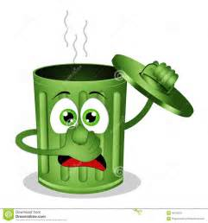
The trash can: Trash it & move on! “Trash can” for Mistakes & poor performances
“Trashing” or leaving behind a mistake or poor performance and moving on, shifting your focus back to taking care of business in the present moment.
After making a mistake or performing poorly, “crumple” it up like a piece of paper and throw it away in the “trash can.” You’re done with it, it’s over!
You know you can do better, so move on and refocus in the present moment to execute play successfully like you’re capable of doing.

Slide 13
PRACTICE – PRACTICE - PRACTICE

Slide 14
imagery
If you can imagine it, you can do it…Nothing happens in reality until it happens in your mind first!
Imagery primes your mind & body to perform successfully. It’s like conditioning a “muscle” - the more you practice imagery, the more you condition your mind & body to perform automatically and effectively during play.
Scripts – for confidence
Visualization
a) control emotions (e.g. see self relaxing on a quiet beach)
b) execution of skills (before or during performance)
c) rehabilitation from injury – to counter negative thoughts and emotions that ca occur when injured

Slide 15
Areas of the Brain with Circuits Involved in Imagery
(visualization)
Anterior-superior
Parietal Lobe
Prefrontal
Lobe
Posterior Occipital
Lobe

Slide 16
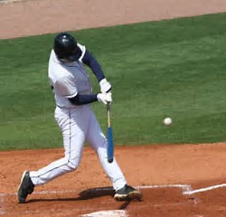
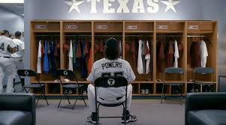
* Write down a detailed description (imagery script) of a best performance, recalling all sights, sounds, physical motions, smells, & tastes that occurred in that moment. Prior to your next performance, re-read the script to re-experience and gain confidence from your best moment.
“I see the field. It’s a sunny, warm, but not scorching hot day. I smell lemon and have the after-taste of the lemon-flavored sports drink in my mouth which feels really refreshing.
I see the field and the spot I want to hit to. I‘m in the batter’s box. I feel the bat in my hand and the muscles of my body relaxed and in the perfect stance.
I see the ball coming at me. It appears large and at a pace that doesn’t intimidate me.
I feel my body again relaxed and in the perfect stance. I swing and make perfect contact for a hit.
I hear the crowd and my teammates cheering me on wildly. I’m rounding all of the bases after hitting a home run and I feel exhilarated by the cheers.
I’m confident. I know I have it in me to hit well. I’ve done it before…I can do it again!”
IMAGERY SCRIPT – RECREATING A BEST PERFORMANCE FOR CONFIDENCE

Slide 17
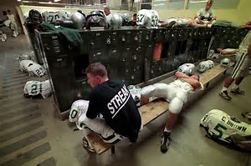
Visualization PRIOR TO PERFORMANCE
Rehearsing in your mind how you will execute a play, routine, or skill prior to performing
Example: Prior to a game, a linebacker reviews, in his mind, offenses he is likely to see from his opponent during the game; he rehearses in his mind/visualizes how he will respond to each.

Slide 18
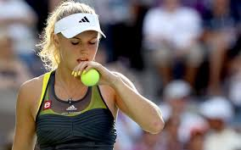
visualization During a performance
Visualizing how you will execute in the moment
Example: Prior to serving, a tennis player visualizes (sees in her mind) hitting the ball to a particular spot on the court.

Slide 19
Imagery for rehab from injury
Imagery helps you manage negative thoughts and emotions related to being injured (e.g. anxiety, frustration, impatience, depression).
Pain Management Imagery
Visualize muscle fibers stretching out and lengthening as they relax
Imagine the sensation of heat or ice on a sore body part
Imagine swelling and pain draining out of an inflamed
For throbbing pain, visualize “bubbles” leaving the body with each throbbing beat
Healing Imagery
In general: visualize yourself in a recovered state
Broken bone: imagine cement filling in a crack in a bone
Torn muscle: visualize muscle fibers braiding together

Slide 20
PRACTICE – PRACTICE - PRACTICE

Slide 21
Goal setting
When you hit a plateau (not getting better in training or performance, it’s hard to feel motivated - goal setting can spark motivation.
Goals should be:
Very specific, measurable, and observable
Time frame (how long will you take to achieve goal?)
Moderate difficulty level (no too easy or hard)
Written down in a journal to monitor your progress
Broken down into a series of smaller goals (break down long-term goal into smaller “baby steps”).
Set for practice as well as competition
Shared with others (who can hold you accountable &motivate you to achieve your marks)
Coaches and training staff can help you determine and outline new goals.

Slide 22
Mental routines
A mental routine is a set of thoughts and behaviors that are done regularly to prepare you for and to bring consistency to your performance.
Research tells us that having mental routines contributes to successful performance
Write down your mental routine and be consistent in performing it before BOTH practice & competitions.

Slide 23
Example: pre-competition mental routine
Listen to music to get psyched-up; use imagery to trigger and re-experience confidence from a best performance.
Do deep breathing and muscle relaxation.
Spot your “trash can” where you will throw away mistakes or poor play during the competition.
Practice imagery for executing during the game (visualize successful execution of relevant plays & strategies) or for confidence (re-experiencing a best performance).

Slide 24
8-MINUTE BEDTIME MENTAL ROUTINE
Practice while in bed prior to falling asleep at night and prior to getting up in the morning.
Think about how you may use the “trash can” for mistakes made at your next practice or competition.
Practice imagery for 5 minutes (e.g. visualize yourself executing a specific skill with excellent technique or executing successfully an important play or routine you are working on currently).
Practice the deep breathing exercise for 1 minute.
Practice one of the muscle relaxation exercises for 1 minute.

Slide 25
PRACTICE – PRACTICE - PRACTICE

Slide 26
Summary – techniques for sharpening mental skills
NOTE: There is science behind how and why techniques work
EMOTION CONTROL
Relaxation - big bad wolf; rag doll
Self talk - wristband
Visualization (e.g. relaxing on a beach)
IMAGINATION FOR EXECUTION
Visualizing the execution of skills, plays, routines
CONFIDENCE
Positive self-talk - wristband
Imagery script
MOTIVATION
Positive self-talk - wristband
Goal-setting
FOCUS/ATTENTION
Mindfulness – trash can
Relaxation - big bad wolf; rag doll
Self-talk - wristband

Slide 27
PRACTICE – PRACTICE - PRACTICE

Slide 31
The mental game
THE MENTAL GAME INVOLVES:
Sharp, well-conditioned mental skills for performance
Awareness of other mental health factors affecting athletic performance

Slide 32
Other MENTAL HEALTH FACTORS IMPACTING PERFORMANCE- awareness is a weapon/advantage!
Mental Disorders Impacting Sports Performance
Psychological Effects of Substances (alcohol/recreational drugs; performance-enhancing drugs or PEDs)
Sleep & Nutrition for Optimal Brain & Neuromuscular Function

Slide 33
1. MENTAL DISORDERS ASSOCIATED WITH SPORTS
Severe Anxiety
Depression
Substance abuse
Eating disorders (anorexia, bulimia, binge eating); female triad
Concussion: Post-concussion syndrome; Chronic Traumatic Encephalopathy or CTE

Slide 34
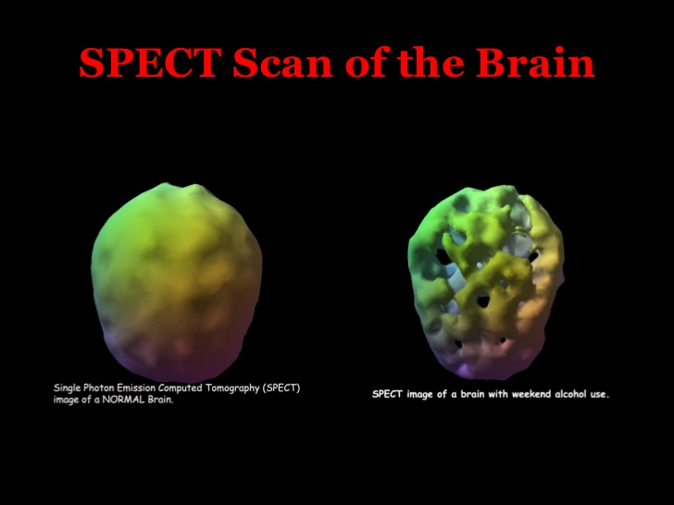
SPECT = single photon emission computed tomography; spect scan measures functioning brain cells; holes indicate areas where brain cells are not functioning
normal brain vs binge alcohol brain (more than 12oz in a sitting,1x/wk)

Slide 35
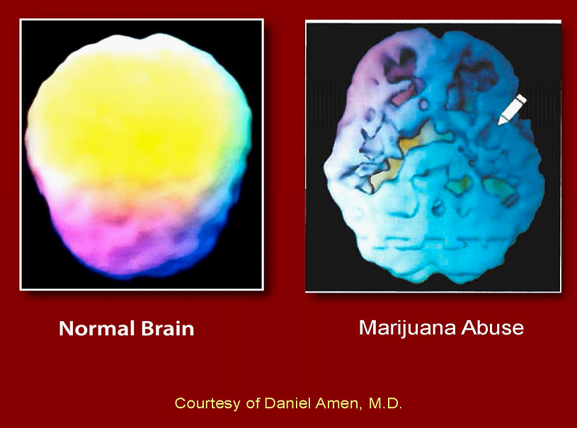
1-2x/weekly

Slide 36
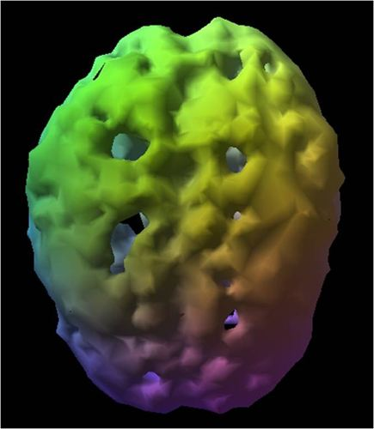
Stimulant abuse (e.g. one-time cocaine or meth; abuse of stimulant ADHD medications)

Slide 37
Ucla counseling & psychological services (caps)
Provides UCLA students mental health care (counseling; medication therapy)
Location: John Wooden Center West - 221 Westwood Plaza
Phone: (310) 825-0768

Slide 38
PERFORMANCE ENHANCING DRUG (PED) | Performance-Enhancing Effect/ Reason for Ban | PSYCHOLOGICAL EFFECTS/SIDE EFFECTS
Anabolic steroids (synthetic testosterone) | Delay fatigue; build muscle | euphoria; anxiety; irritability; psychosis; withdrawal
Illegal street drugs (meth, heroin, mushrooms) | Illegal | mania, psychosis, anxiety, withdrawal (opiates, stimulants)
Stimulants (Adderall, meth,cocaine) | increased energy & motivation; delay fatigue; increased alertness, decreased appetite | mania; psychosis; depression &fatigue during withdrawal
Masking agents/diuretics (water pills) | Enhances water loss & dilutes urine making it hard to detect PEDs | mood instability; confusion/delirium
Alcohol & Beta Blockers (propranolol) | Decrease elevated heart rate, blood pressure, and tremulousness associated with anxiety | Beta blocker: depression, sleep disturbance. Alcohol: anxiety, sleep disturbance, mood instability, psychosis, withdrawal
Anti-estrogens (tamoxifen, clomiphene) | Some increase production of testosterone & masks some steroids | mood swings, anxiety, insomnia
Peptide Hormones & analogues (HGH/growth hormone) | Promotes vitality, growth of bone & muscle, and reduces fat; speeds healing | depression, psychosis
Beta-2 agonists (asthma medication) | Stimulates opening of lung airways permitting more oxygen intake | anxiety
NOTE: BEWARE OF SUPPLEMENTS

Slide 39
3. SLEEP & NUTRITION
A) Healthy Sleep Habits
B) Foods for optimal brain & neuromuscular function (note: nerves stimulate muscles)

Slide 40
A) Healthy Sleep Routine
During sleep – regulation of hormones affecting stress, appetite, cell growth, and cell repair.
1) Begin an unwinding routine at least 1hr before bedtime. During this time wind down stimulating or disruptive influences (e.g. video games, internet or tv channel surfing, stressful interactions with others).
2) Set a regular bedtime and make efforts to adhere to it even if not tired.
3) Make efforts to arise at the same time each morning.
4) Practice relaxation exercises in the evening (e.g. breathing, muscle relaxation).
5) Ensure a comfortable sleep space.
6) Limit activating substances (e.g. caffeine, alcohol, nicotine) especially in the later part of the day.
7) Get support for any psychological issues, if they are contributing factors to a sleep disturbance.

Slide 41
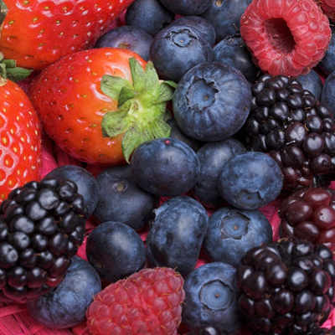
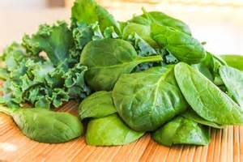
B) Nutrition
1) BERRIES (*especially blueberries) contain flavanoids = antioxidant
2) LEAFY GREENS (e.g. kale, cabbage, spinach) contain B-complex; minerals (especially iron)

Slide 42
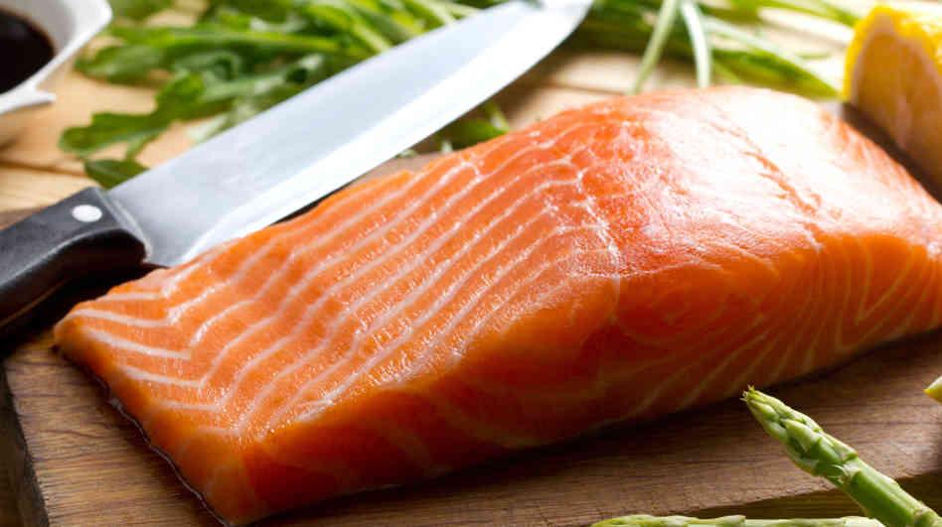
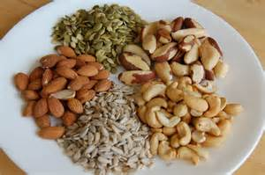
3) FISH (e.g. salmon, tuna, herring): omega-3 fatty acids
4) NUTS & SEEDS (e.g. walnut, almond, cashew; sunflower, pumpkin seeds): omega fatty acids, B9 (folate), B6, Vit E, Mg+

Slide 43
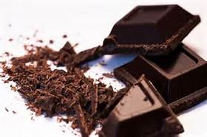
Brain health: NUTRITION
5) DARK CHOCOLATE: contains cocoa = antioxidant

Slide 44
Summary
Awareness
of mental health factors impacting performance is a weapon/advantage!

Slide 48
resources
For a copy of slide shows or mental skills exercises for specific sports:
improveyourmentalgame.com/more resources
For Free E-book:
improveyourmentalgame.com/free pdf download
For questions or more info: pasmith@ucla.edu – Go Bruins!

